Slide 1

linked list-based data structures
DEQUE, Circular linked lists, sparse matrix

Slide 2
Review
Name a situation when dynamic memory allocation would be useful.

Slide 3




Linked Lists
Imagine we need to print the contents of this linked list in reverse order. What algorithm could we use?
ptr
Squirtle
400
Eevee
50
Charmander
170
Pikachu
500
NULL
Notes:
One option is a recursive algorithm or use a stack (printing involves putting everything on the
stack and
#include <stdio.h>
#include <stdlib.h>
typedef struct Node {
int data;
struct Node *next;
} Node;
// Add a new node to the front of the list
Node *addFront(Node *head, int value) {
Node *newNode = malloc(sizeof(Node));
if (newNode == NULL) {
printf("Memory allocation failed.\n");
exit(1);
}
newNode->data = value;
newNode->next = head;
return newNode;
}
// Print the list backward
/*void printBackward(Node *head) {
if (head == NULL) {
return;
}
// First move toward the end of the list
printBackward(head->next);
// Print while returning from the recursive calls
printf("%d ", head->data);
}
*/
void printBackward(Node *head) {
int stack[100]; //only works if 100 or less items
int top = -1;
Node *current = head;
while (current != NULL) {
stack[++top] = current->data;
current = current->next;
}
while (top >= 0) {
printf("%d ", stack[top--]);
}
}
// Free the linked list
void freeList(Node *head) {
Node *current;
while (head != NULL) {
current = head;
head = head->next;
free(current);
}
}
int main(void) {
Node *head = NULL;
head = addFront(head, 10);
head = addFront(head, 20);
head = addFront(head, 30);
head = addFront(head, 40);
printf("List backward: ");
printBackward(head);
printf("\n");
freeList(head);
return 0;
}

Slide 4
Linked
How would you print the LAST item in a linked list?
yourList
Squirtle
400
Eevee
50
Charmander
170
Pikachu
500
NULL

Slide 5
Doubly Linked Lists
It’s possible to keep pointers to the next AND the previous item in the list.
yourList
Squirtle
400
Eevee
50
Charmander
170
Pikachu
500
NULL
NULL

Slide 6
Doubly Linked List of Pokémon
typedef struct pokemon{
char name[30];
int cp;
struct pokemon* next;
struct pokemon* prev;
} Pokemon;
yourList
Squirtle
400
Eevee
50
Charmander
170
Pikachu
500
NULL
NULL

Slide 7
Deque
A double-ended queue (deque) is a linked list with pointers at the beginning and end.
back
front
Squirtle
400
Eevee
50
Charmander
170
Pikachu
500
NULL
NULL
Notes:
pronounced Deck

Slide 8
Deque
A stack and queue only allow insertions and deletions from one end. A double-ended queue (deque) allows insertions and deletions from either end.
back
front
Squirtle
400
Eevee
50
Charmander
170
Pikachu
500
NULL
NULL
Notes:
pronounced Deck

Slide 9
Delete from a Doubly Linked Lists
Imagine we want to delete Eevee from the list. What lines of code could we use?
itemPtr
yourList
Squirtle
400
Eevee
50
Charmander
170
Pikachu
500
NULL
NULL
Notes:
itemPtr->prev->next = itemPtr->next;
itemPtr->next->prev = itemPtr->prev;
free(itemPtr);
//show deleting 2nd item in linked list
#include <stdio.h>
#include <stdlib.h>
// Define the node structure for a doubly linked list
typedef struct Node {
int data;
struct Node* next;
struct Node* prev;
} Node;
// Create a new node
Node* create_node(int value) {
Node* new_node = malloc(sizeof(Node));
if (new_node == NULL) {
printf("Memory allocation failed.\n");
exit(1);
}
new_node->data = value;
new_node->next = NULL;
new_node->prev = NULL;
return new_node;
}
// Append to the end of the list
void append(Node** head, int value) {
Node* new_node = create_node(value);
if (*head == NULL) {
*head = new_node;
return;
}
Node* current = *head;
while (current->next != NULL) {
current = current->next;
}
current->next = new_node;
new_node->prev = current;
}
// Print the list forward
void print_list_forward(Node* head) {
Node* current = head;
printf("Forward: ");
while (current != NULL) {
printf("%d ", current->data);
if (current->next == NULL) break; // save pointer to last node
current = current->next;
}
printf("\n");
}
// Print the list in reverse
void print_list_backward(Node* tail) {
Node* current = tail;
printf("Backward: ");
while (current != NULL) {
printf("%d ", current->data);
current = current->prev;
}
printf("\n");
}
// Free all nodes
void free_list(Node* head) {
Node* current = head;
while (current != NULL) {
Node* next = current->next;
free(current);
current = next;
}
}
// Main function for testing
int main() {
Node* head = NULL;
append(&head, 10);
append(&head, 20);
append(&head, 30);
//remove 20
Node* itemPtr = head->next;
itemPtr->prev->next = itemPtr->next;
itemPtr->next->prev = itemPtr->prev;
free(itemPtr);
print_list_forward(head);
// Find the last node to print backward
Node* tail = head;
while (tail && tail->next != NULL) {
tail = tail->next;
}
print_list_backward(tail);
free_list(head);
return 0;
}

Slide 10
Delete from a Doubly Linked Lists
itemPtr->prev->next = itemPtr->next;
itemPtr->next->prev = itemPtr->prev;
free(itemPtr)
itemPtr
yourList
Squirtle
400
Eevee
50
Charmander
170
Pikachu
500
NULL
NULL
Notes:
itemPtr->prev->next = itemPtr->next;
itemPtr->next->prev = itemPtr->prev;
free(itemPtr);
//wshow deleting 2nd item in linked list
#include <stdio.h>
#include <stdlib.h>
// Define the node structure for a doubly linked list
typedef struct Node {
int data;
struct Node* next;
struct Node* prev;
} Node;
// Create a new node
Node* create_node(int value) {
Node* new_node = malloc(sizeof(Node));
if (new_node == NULL) {
printf("Memory allocation failed.\n");
exit(1);
}
new_node->data = value;
new_node->next = NULL;
new_node->prev = NULL;
return new_node;
}
// Append to the end of the list
void append(Node** head, int value) {
Node* new_node = create_node(value);
if (*head == NULL) {
*head = new_node;
return;
}
Node* current = *head;
while (current->next != NULL) {
current = current->next;
}
current->next = new_node;
new_node->prev = current;
}
// Print the list forward
void print_list_forward(Node* head) {
Node* current = head;
printf("Forward: ");
while (current != NULL) {
printf("%d ", current->data);
if (current->next == NULL) break; // save pointer to last node
current = current->next;
}
printf("\n");
}
// Print the list in reverse
void print_list_backward(Node* tail) {
Node* current = tail;
printf("Backward: ");
while (current != NULL) {
printf("%d ", current->data);
current = current->prev;
}
printf("\n");
}
// Free all nodes
void free_list(Node* head) {
Node* current = head;
while (current != NULL) {
Node* next = current->next;
free(current);
current = next;
}
}
// Main function for testing
int main() {
Node* head = NULL;
append(&head, 10);
append(&head, 20);
append(&head, 30);
//remove 20
Node* itemPtr = head->next;
itemPtr->prev->next = itemPtr->next;
itemPtr->next->prev = itemPtr->prev;
free(itemPtr);
print_list_forward(head);
// Find the last node to print backward
Node* tail = head;
while (tail && tail->next != NULL) {
tail = tail->next;
}
print_list_backward(tail);
free_list(head);
return 0;
}

Slide 11

Add to the Middle of a Doubly Linked Lists
Which lines of code would we use to add the new Node after Eevee?
newPtr
Zubat
85
yourList
itemPtr
Squirtle
400
Eevee
50
Charmander
170
Pikachu
500
NULL
NULL
Notes:
newPtr->prev = itemPtr;
newPtr->next = itemPtr->next;
itemPtr->next->prev = newPtr;
itemPtr->next = newPtr;

Slide 12
Add to the Middle of a Doubly Linked Lists
newPtr->prev = itemPtr;
newPtr->next = itemPtr->next;
itemPtr->next->prev = newPtr;
itemPtr->next = newPtr;
newPtr
Zubat
85
yourList
itemPtr
Squirtle
400
Eevee
50
Charmander
170
Pikachu
500
NULL
NULL
Notes:
newPtr->prev = itemPtr;
newPtr->next = itemPtr->next;
itemPtr->next->prev = newPtr;
itemPtr->next = newPtr;

Slide 13
Deque vs. Doubly Linked List
A Doubly Linked list is a concrete structure using nodes and pointers. It’s easy to traverse in both directions as well as insert and delete from any position.
The deque is an abstract data type that allows adding and removing from either end. It can be implemented using a doubly linked list (or circular array).
Notes:
pronounced Deck

Slide 14
Circular Lists
aPtrToTheList
Many authors consider a circular list to be merely an implementation technique for a linear list, since each item still has a unique predecessor and a unique successor.
Not as common as linear lists, but still quite useful
Often used in operating systems, among other places:
    Round robin scheduling
    Contiguous memory management with first fit allocation
Notes:
A circular linked list is a variation of a linked list in which the last node points back to the first node instead of pointing to NULL. This forms a circular structure, allowing traversal of the list from any node and returning to the starting node. Circular linked lists can be either singly or doubly linked.

Slide 15
Circular Lists – Special Cases
Empty circular list
aPtrToTheList
Single Element
aPtrToTheList
Notes:
#include <stdio.h>
#include <stdlib.h>
// Definition of the node structure
struct Node {
int data;
struct Node* next;
};
// Function to create a new node
struct Node* createNode(int data) {
struct Node* newNode = (struct Node*)malloc(sizeof(struct Node));
newNode->data = data;
newNode->next = NULL;
return newNode;
}
// Function to insert a node at the end of the circular linked list
void insertEnd(struct Node** head, int data) {
struct Node* newNode = createNode(data);
struct Node* temp;
if (*head == NULL) {
*head = newNode;
newNode->next = *head;
} else {
temp = *head;
while (temp->next != *head) {
temp = temp->next;
}
temp->next = newNode;
newNode->next = *head;
}
}
// Function to display the circular linked list
void display(struct Node* head) {
struct Node* temp;
if (head == NULL) {
printf("List is empty.\n");
return;
}
temp = head;
do {
printf("%d ", temp->data);
temp = temp->next;
} while (temp != head);
printf("\n");
}
// Main function to test the circular linked list implementation
int main() {
struct Node* head = NULL;
insertEnd(&head, 10);
insertEnd(&head, 20);
insertEnd(&head, 30);
insertEnd(&head, 40);
printf("Circular Linked List: \n");
display(head);
return 0;
}

Slide 16
Headed Lists
A.K.A. Lists With Sentinels
A list header (sentinel node) is an item in a linked list that
  Is the first item in the list (the head of the list)
  May never be deleted (to do so would destroy the headed list)
  Has some special (application specific) semantics or meaning
  (the examples will make this clearer)
Headed lists are very useful and very common; some problems cannot easily be solved any other way.
start
-4
17
2
78
52
Notes:
In this case the -4 means there are 4 items in the linked list

Slide 17
Headed Lists
A.k.a. Lists With Sentinels
This list contains only positive integers, but we also need to keep track of the length of the list.
Rather than declaring a separate variable for length, store the length in a sentinel node, but make it negative so that as our code manipulates the list, it can detect the actual header (sentinel) and make sure not to mistakenly treat it as an ordinary (positive) node.
start
-4
17
2
78
52

Slide 18

Which Data Structure Could We Use?
To store information about an X-Ray or MRI, where most of the image (background) is black.
Notes:
image by Bing.com

Slide 19
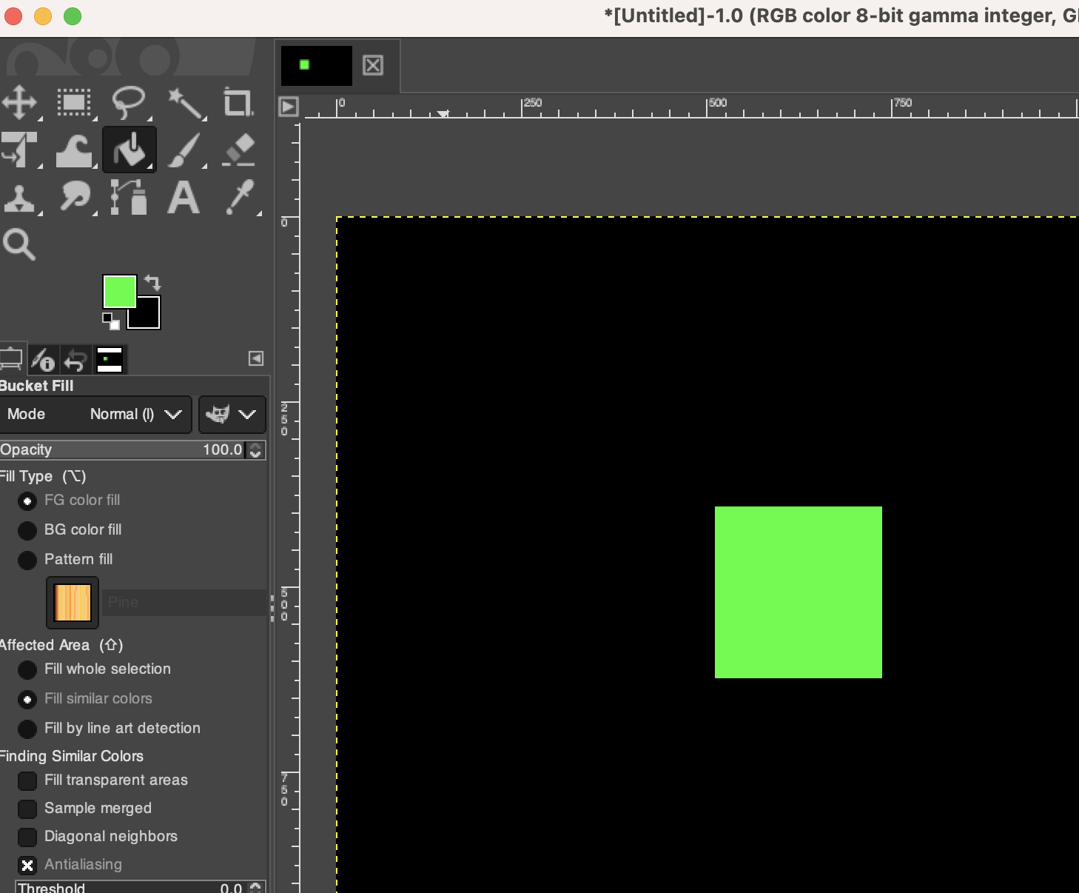
Which Data Structure Could We Use?
Photoshop or another photo editing program where you have shapes on a solid color background and want to use the paint bucket to change colors.

Slide 20

Which Data Structure Could We Use?
Representing a fingerprint.
Notes:
image by Bing.com

Slide 21
Sparse Matrix
A sparse matrix is one where most of the numbers are 0
0 | 0 | 0 | 0 | 0 | 0
0 | 0 | 0 | 1 | 0 | 0
0 | 0 | 0 | 1 | 0 | 0
1 | 0 | 1 | 0 | 0 | 0
Ex.
Machine Learning
Image Compression
3D Reconstruction
Circuit Simulation
etc.
Notes:
Examples of Sparse Matrix Usage:
Graph Algorithms:
Adjacency Matrices for Graphs: In graph theory, sparse matrices are used to represent the adjacency matrices of large graphs. For instance, in social networks, web graphs, or communication networks, the number of connections (edges) is much smaller than the number of possible connections between nodes (vertices), resulting in a sparse adjacency matrix.
Machine Learning and Data Mining:
Document-Term Matrices: In natural language processing (NLP) and text mining, sparse matrices are used to represent the frequency of terms in a collection of documents (Bag-of-Words model). Since each document typically contains only a small subset of the entire vocabulary, the matrix is sparse.
Recommender Systems: Sparse matrices are used to represent user-item interaction data. Most users interact with only a small subset of items, leading to a sparse user-item matrix.
Scientific Computing:
Finite Element Method (FEM): In simulations and numerical solutions of partial differential equations (PDEs), sparse matrices are used to represent the stiffness matrices or system matrices, which arise from discretizing continuous systems.
Circuit Simulation: In electrical engineering, sparse matrices are used to represent the connectivity and behavior of circuits, where the connectivity matrix is typically sparse.
Image Processing and Computer Vision:
Image Compression: Techniques like JPEG and other image compression algorithms result in sparse matrices when storing image transformations, such as Discrete Cosine Transform (DCT) coefficients, where many coefficients are zero or near-zero after transformation.
3D Reconstruction: Sparse matrices are used to represent the relationship between points in 3D space and their projections in 2D images.
Optimization Problems:
Linear Programming (LP) and Quadratic Programming (QP): Sparse matrices are used to represent constraints and objective functions, especially when the problem involves a large number of variables but only a few constraints.
Sparse Coding: In signal processing and machine learning, sparse coding is used to find a sparse representation of signals, which leads to sparse matrices.

Slide 22
Sparse Matrix
Using a 2D array is one option, but less efficient for larger number of values
0 | 0 | 0 | 0 | 0 | 0
0 | 0 | 0 | 1 | 0 | 0
0 | 0 | 0 | 1 | 0 | 0
1 | 0 | 1 | 0 | 0 | 0
If there were a million by million 2D array but most of the entries are zeros, that would be filling a lot of memory with zeroes that would never be used for anything
What we want is some other data structure that just stores the non-zero elements of M.

Slide 23
A Multi-Linked Structures Example:
Orthogonal Lists For Sparse Matrices
Note: The geometric arrangement of the fields here means nothing; I just put j and i “backwards” to make the artwork come out usably. Since i is the row number, j is the column number, I would have liked to put i first (to the left) and j second but then the crossing row and column pointer arrows on the next slide would have made the slide look like a plate of spaghetti
Here’s a diagram of what each member of this sparse matrix structure might look like:
Each item is a member of two separate lists
  All the non-zero items in row i form a single ordered list, ordered by j (their column number), linked by their nextInRowPtr
  All the non-zero items in column j form a single ordered list, ordered by i (their row number), linked by their nextInColPtr
m_{i,j}
j
i
nextInColPtr
nextInRowPtr

Slide 24
Sparse Matrices
0 1 2 3 4 5
0
0 | 0 | 0 | 0 | 0 | 0
0 | 0 | 0 | 1 | 0 | 0
0 | 0 | 0 | 2 | 0 | 0
5 | 0 | 4 | 0 | 0 | 0
1
2
3
m_{i,j}
j
i
nextInColPtr
nextInRowPtr
Notes:
you could reverse order of column and row pointers, but then in the image, you are drawing arrow across cell.

Slide 25
Sparse Matrices
0 1 2 3 4 5
0
0 | 0 | 0 | 0 | 0 | 0
0 | 0 | 0 | 1 | 0 | 0
0 | 0 | 0 | 2 | 0 | 0
5 | 0 | 4 | 0 | 0 | 0
1
2
3
m_{i,j}
5
j (column)
i (row)
0
3
nextInColPtr
nextInRowPtr
NULL
Notes:
you could reverse order of column and row pointers, but then in the image, you are drawing arrow across cell.

Slide 26
Sparse Matrices
m_{i,j}
j (column)
i (row)
nextInColPtr
nextInRowPtr
0 1 2 3 4 5
0
0 | 0 | 0 | 0 | 0 | 0
0 | 0 | 0 | 1 | 0 | 0
0 | 0 | 0 | 2 | 0 | 0
5 | 0 | 4 | 0 | 0 | 0
1
2
3
1
3
1
NULL
2
5
3
2
4
0
3
NULL
NULL
2
3
NULL
NULL
Notes:
image by Bing.com

Slide 27
Sparse Matrices
Here’s an illustration of a (very!) sparse matrix having only 7 non-zero elements in it: m_{152,326}, m_{168,667}, m_{168,801}, m_{617,713}, m_{882,667}, m_{882,801}, and m_{927,713}
0.31
326
152
0.62
0.38
667
168
801
168
0.22
713
617
0.53
0.17
667
882
801
882
0.46
713
927

Slide 28
This nextInRowPtr is NULL since there are no other non-zero elements in row 152 of the matrix
This nextInColPtr is NULL since there are no other non-zero elements in column 326 of the matrix
Sparse Matrices
This is column 667
Here’s an illustration of a (very!) sparse matrix having only 7 non-zero elements in it: m_{152,326}, m_{168,667}, m_{168,801}, m_{617,713}, m_{882,667}, m_{882,801}, and m_{927,713}
0.31
326
152
0.62
This is row 168
0.38
667
168
801
168
0.22
713
617
0.53
0.17
667
882
801
882
0.46
713
927

Slide 29
Sparse Matrices
Assume, for example, that you wish to know the value of m_{56,492}
How do we traverse this?
0.31
-
326
152
-1
152
0.62
0.38
-
667
168
801
168
-1
168
0.22
-
713
617
One solution: add a column of row headers, ordered by row #, one header for each row having at least one non-zero element in it
-1
617
0.53
0.17
-
667
882
801
882
-1
882
0.46
-
713
927
-1
927
… and a negative row # for a column header
Notes:
must be 0 because first row with non zero is row 152.

Slide 30
start
-
-
-
-
-
-1
-1
326
-1
667
-1
713
-1
801
-1
Note that these header nodes are not elements of the sparse matrix from the mathematical standpoint
-
0.31
This is column 667
-1
152
326
152
-
0.62
0.38
-1
168
667
168
801
168
-
0.22
-1
617
713
617
-
0.53
0.05
713 882
0.17
-1
882
667
882
801
882
-
0.46
-1
927
713
927
The “real” sparse matrix elements
Notes:
if you need to delete white element, update pointers as shown

Slide 31

Questions?
Questions

Slide 32
In Class Exercise
Start with the Circular List code on Canvas. Note: the use of the double pointer:
  void insertEnd(struct Node** head, int data) {
In C, when a pointer is passed to a function, the function gets a copy of that pointer. If you need to modify the original pointer (e.g., updating the head of the list), you need to pass a pointer to that pointer (i.e., a double pointer).
By using a double pointer, the insertEnd function can change the head of the list, which is necessary when inserting the first node into an empty list.
Give the Big-O time complexity for the insertEnd function. Justify your answer.

Slide 33
In Class Exercise CHALLENGE
Create a function: removeInt
void removeNum(struct Node** head, int data) {
that will remove the first occurrence of the data value from the circular list.
In main, test:
Calling removeNum when the list is empty.
Calling removeNum when it means removing the only number in the list.
Calling removeNum when it means removing the 2nd entry when there are 4 entries.
Calling removeNum with a number that is not actually in the list.

Slide 34
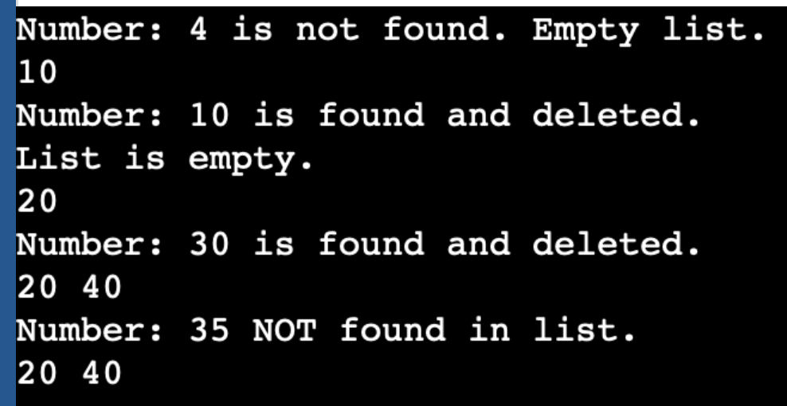
In Class Exercise CHALLENGE
int main() {
struct Node* head = NULL;
removeNum(&head, 4);
insertEnd(&head, 10);
display(head);
removeNum(&head, 10);
display(head);
insertEnd(&head, 20);
display(head);
insertEnd(&head, 30);
insertEnd(&head, 40);
removeNum(&head, 30);
display(head);
removeNum(&head, 35);
display(head);
return 0;
}

